Slide 1
Fourier Analysis
Fourier Series, Transform, and more…

Slide 2
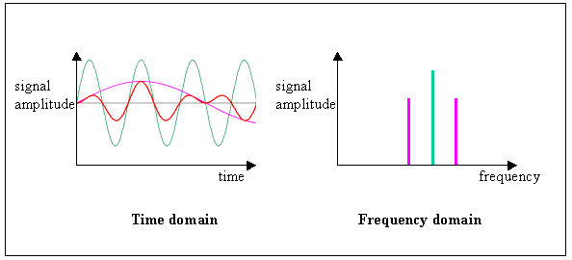
Time Domain vs. Frequency Domain

Slide 3
Fourier Analysis in Nature
Almost all the signal analysis in nature is in frequency domain.
Frequency Domain Analysis is hard to understand because you can’t think in abstract frequency domain. Our minds are trained to think in time domain.
But most of the signal processing at the hardware level in human body is done in frequency domain

Slide 4
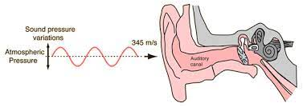
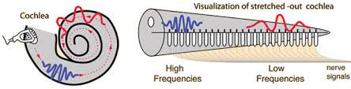
Sound Processing in Human Ear
Our ears use frequency analysis to process different sounds

Slide 5
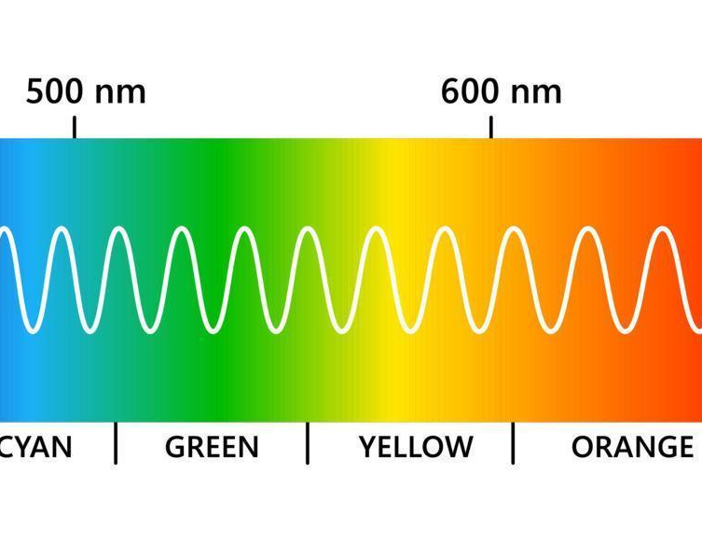
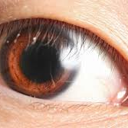
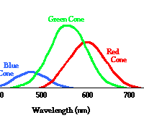
Light Processing in Human Eye
Human Eyes have very sophisticated sensors which separate out different frequencies from light and then process it in frequency domain

Slide 6
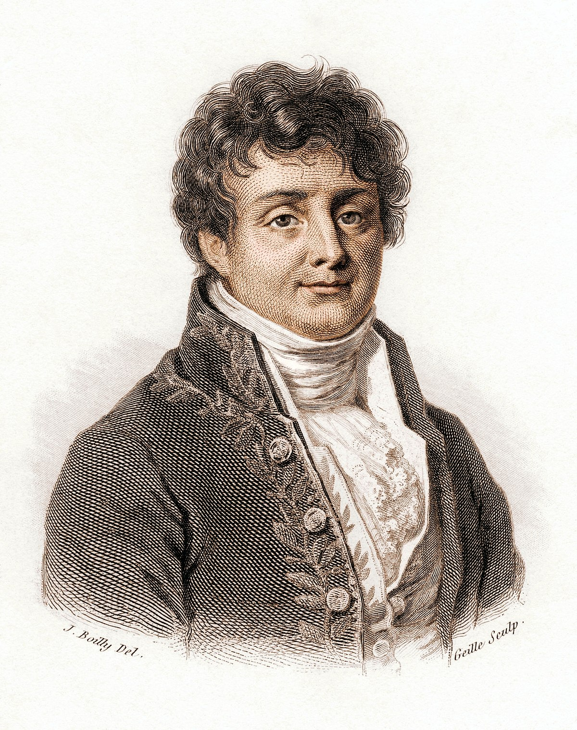
Joseph Fourier (1768-1830)
Noticed a strange phenomena in 1807 while working on a heat-flow problem.
Later developed the Mathematical form of what is now known as the Fourier Analysis
Known to be one of the most important algorithms of human history

Slide 7
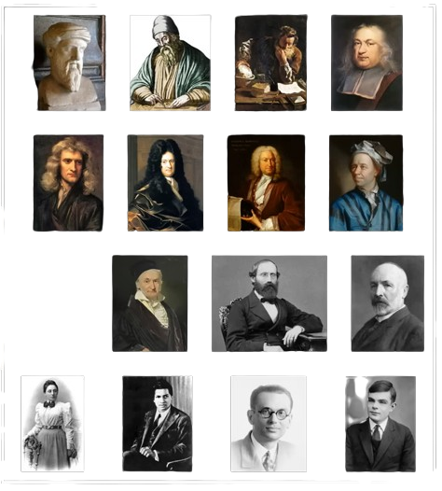
The Immortals of Math

Slide 8
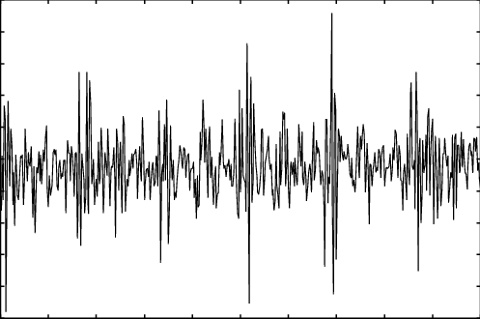
What is so “important” about Fourier Analysis?
Simplifies the signal analysis (Maybe Not ☺)
Allows processing on signals which are impossible to work with in time domain; i.e., sound waves or radio waves.

Slide 9
Processing Signal in Time-Domain
Consider a microphone that converts sound waves to electrical signal. Given below is the graph of the electrical signals produced by the microphone. Try to remove the background noise from this graph while staying in the time domain.

Slide 10
IMPOSSIBLE!!!!

Slide 11
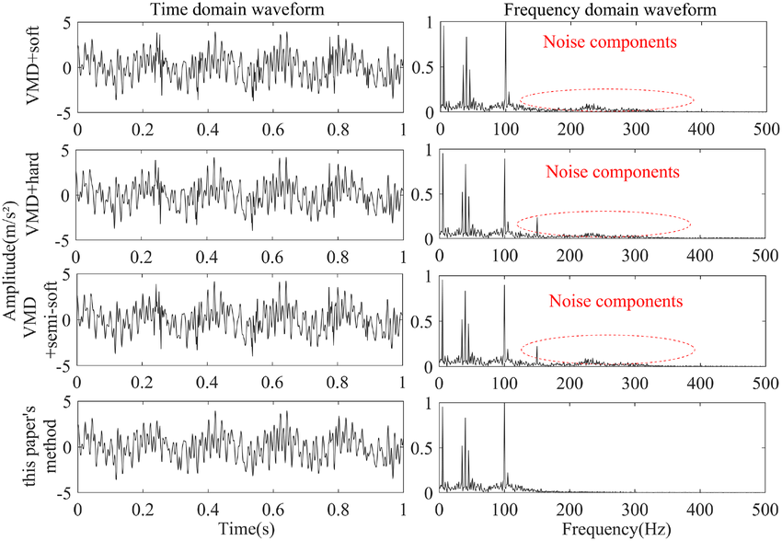
Going from Time-Domain to Frequency Domain
After going to frequency domain, you can easily remove the noise components

Slide 12
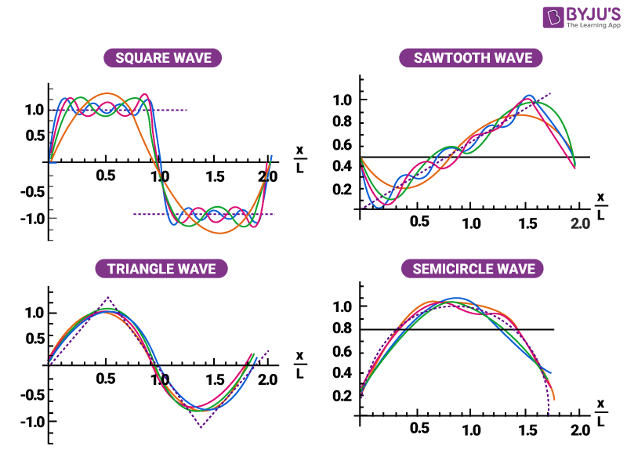
Fourier Series
Any periodic function can be approximated as the sum of sine and cosine harmonics.

Slide 13
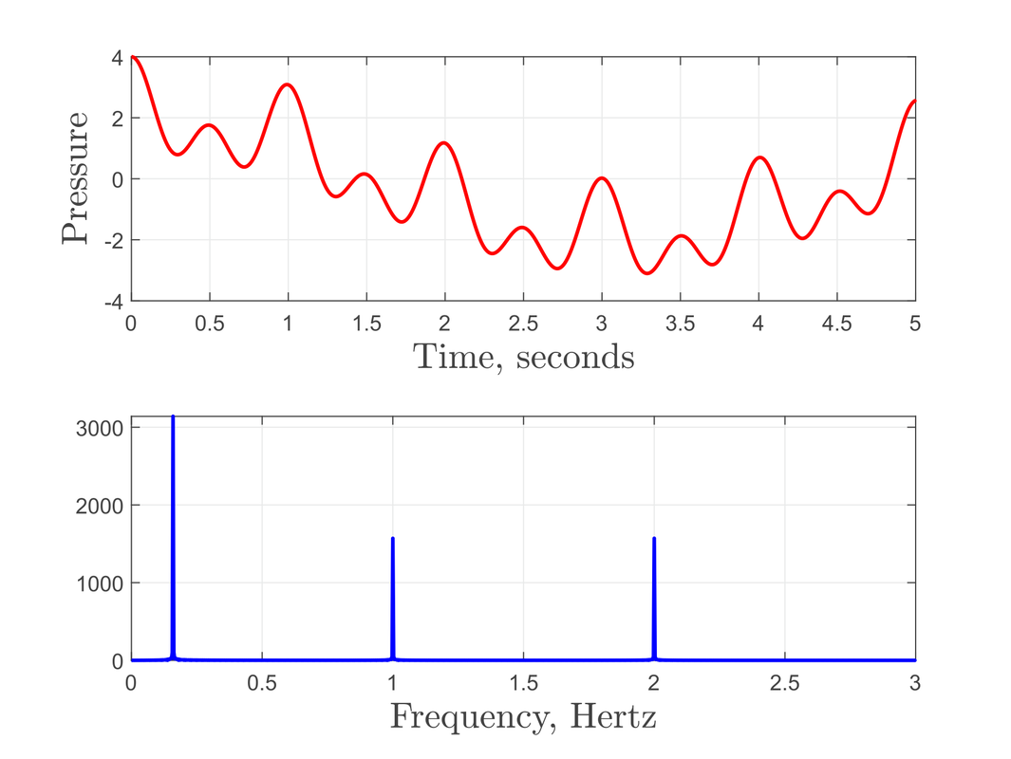
Fourier Transform
Converting a signal from time domain to frequency domain
After processing, the signal can be converted back to time domain using the Inverse Fourier Transform

Slide 14
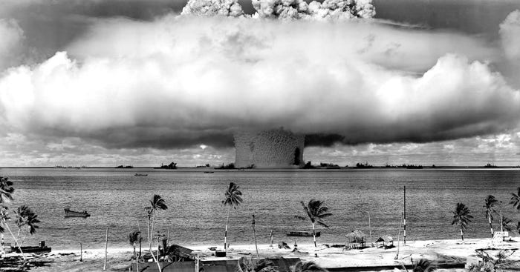
Fast Fourier Transform
Invented in 1965 and put an end to nuclear arms race

Slide 15
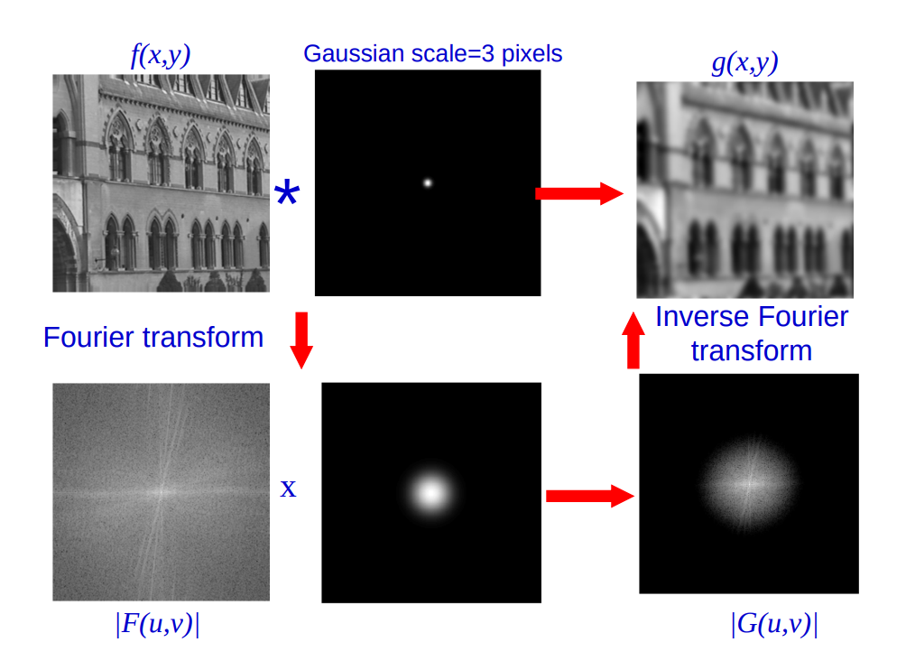
Applications in Image Processing
FFT is used in Image Compression algorithms like Jpeg.
It is also used in Video Compression Algorithms like MPEG x264

Slide 16
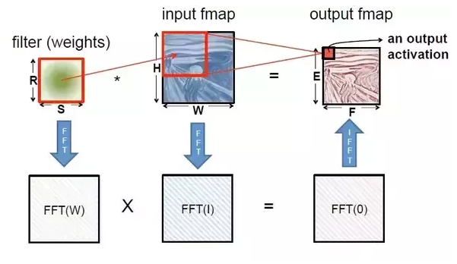
Applications in Computer Vision & Machine Learning
Almost all the advanced Computer Vision and Machine Learning Algorithms use the Fast Fourier Transform to transform and compress the data set

Slide 17
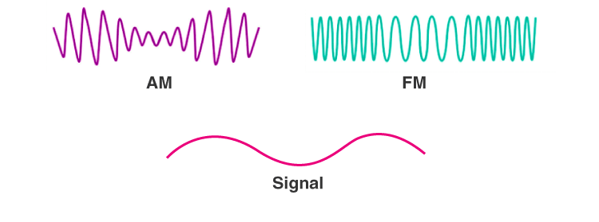
Fourier Transform in Radio Modulation

Slide 18
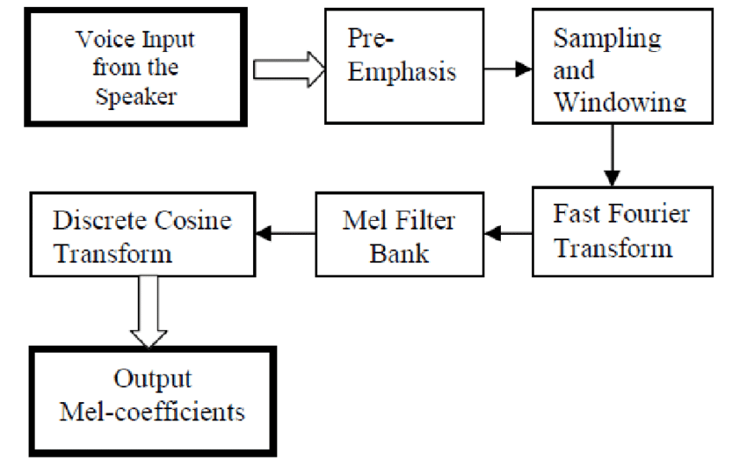
Fourier Transform in Speech Recognition
MFCC algorithm

